Slide 1
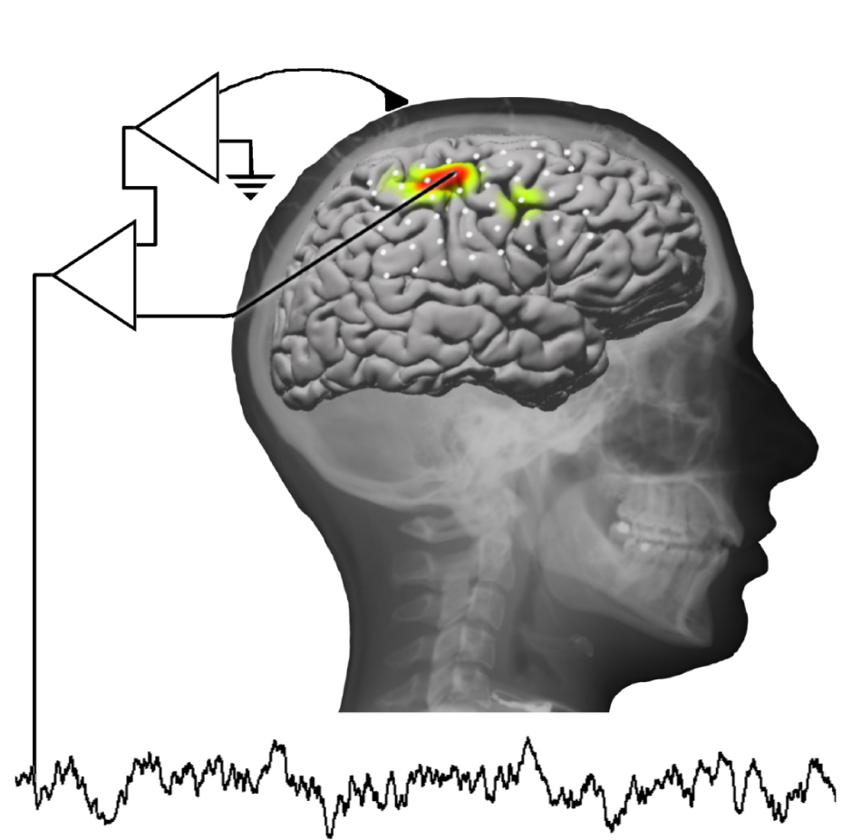
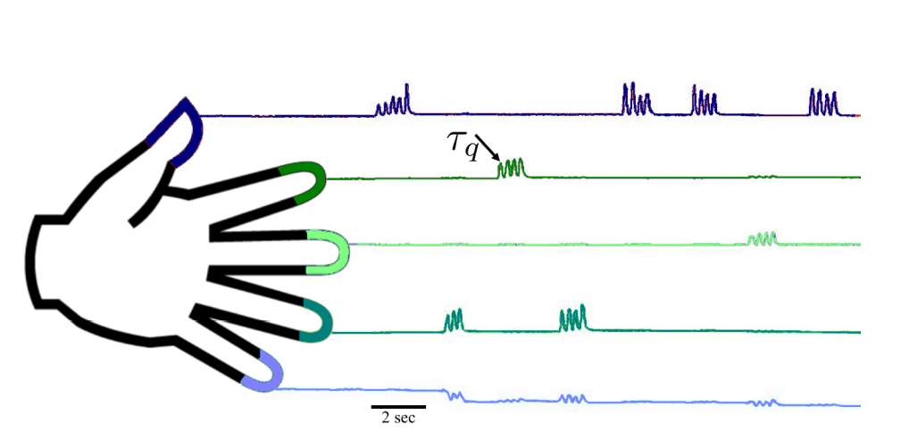
BE521 Final Project: Competition
3/26/21

Slide 2
Project Part 1 has been released!

Slide 3
Team Registration
Need 2-3 members per team
Register as soon as possible (by Mar 31st) on the website
Use your upenn.edu email address
Be creative with team name, BUT keep it <100 characters and just use alphanumeric characters and spaces (PLEASE DON’T USE PUNCTUATION OR SPECIAL CHARACTERS)
You’ll get an email confirmation after registration
Don’t register more than once

Slide 4

What exactly is this competition?
Notes:
3 patients with epilepsy - ecog implants

Slide 5
The data
3 epileptic patients with subdural electrode grids
Electrocorticographic (ECoG) signals (i.e., 62, 48, and 64 channels from subjects 1, 2, and 3, respectively) were acquired, band pass filtered between 0.15 to 200 Hz, and sampled at 1000 Hz.
NOTE: For final_project part 1, we removed channel 55 in subject 1, and we removed channels 21 and 38 from subject 2. The complete subject data is provided in Files/Homeworks/Final_Project_Competition on canvas
Subjects wear a glove to record finger movement

Slide 6
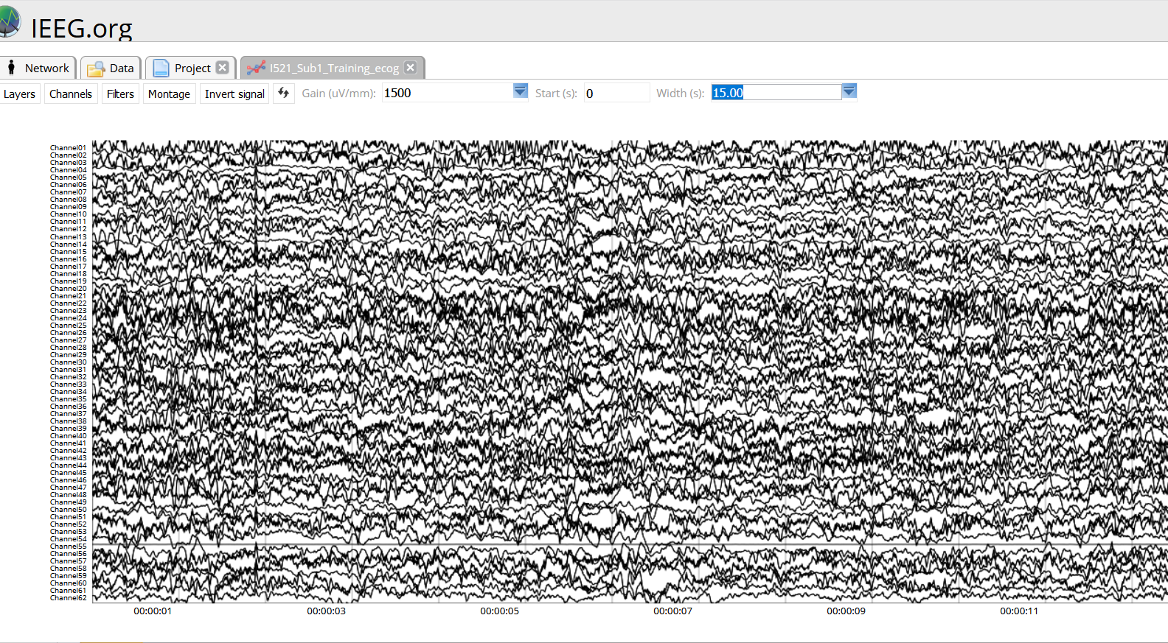
Notes:
Channel 55 was removed from subject 1 (example)

Slide 7
The Experiment
Each subject cued to move a particular finger by displaying the corresponding word (e.g., "thumb") on a computer monitor.
2 sec cue, 2 second rest period (blank screen)
During each cue, subject moved the requested finger up and down a few times (avg 3-5 times)
30 cues for each finger (total of 150 cues), interleaved randomly
Experiment lasted 10 minutes per subject: (30 movements per finger) X (5 fingers) X (4 seconds/movement) = 600 seconds = 10 min

Slide 8
The data structure
Access all data from ieeg portal. E.g. subject 1:
Training_ecog - Training ECoG
Training_dg - Training Data Glove
Leaderboard_ecog - Testing ECoG for leaderboard submissions
NOTE: each dataset should be of size 300,000 samples
Goal: develop an algorithm to use the ECoG to predict finger flexion that is captured by the Data Glove. Accuracy of your prediction will be computed as the average correlation coefficient (r) between the actual and predicted flexion recordings, across 3 subjects, and for fingers 1,2,3,5 (ring finger won’t be used for evaluation b/c its movement is correlated with other fingers)

Slide 9
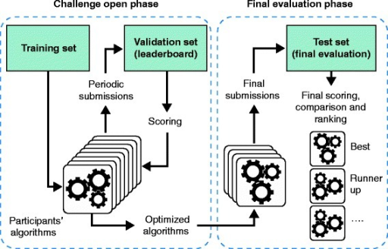
Test set
Validation set
Training set
Notes:
Typical design of a crowd-sourced challenge. A dataset is split into a training set, a validation (or leaderboard set) and the test set (or gold standard). Participants have access to the challenge input data and the known answers for just the training set. For the validation and test sets only, the challenge input data are provided but the answers to the challenge questions are withheld. In the challenge open phase, participants optimize their algorithms by making repeated submissions to predict the validation set answers. These submissions are scored and returned to the participants who can use the information to improve their methods. In the final evaluation phase, the optimized algorithms are submitted and evaluated against the final test set (the gold standard), and the resulting scores are used to compute the statistical significance and the ranking of the participating algorithms.

Slide 10
Deliverables: Leaderboard submission
For the leaderboard:
Leaderboard submissions must be a .mat file named predictions.mat with one variable: predicted_dg. This variable is a 3 x 1 cell array, where predicted_dg{i} corresponds to the predictions for subject i. (See code on next slide)
Thus, predicted_dg{1} is a 147,500 x 5 dimensional matrix for the 147,500 time points and 5 fingers predicted from subject 1's testing ECoG.
MAKE SURE THAT YOUR SUBMISSION IS OF THIS EXACT FORMAT AND SIZE!
Otherwise, your submission will fail

Slide 11
Leaderboard submissions: saving variables into .mat
import numpy as np
from scipy.io import savemat
#create an example submission array
predictions = np.zeros((3,1), dtype=object)
predictions[0,0] = np.random.rand(147500, 5)
predictions[1,0] = np.random.rand(147500, 5)
predictions[2,0] = np.random.rand(147500, 5)
#save the array using the right format savemat('predictions.mat', {'predicted_dg':predictions})

Slide 12
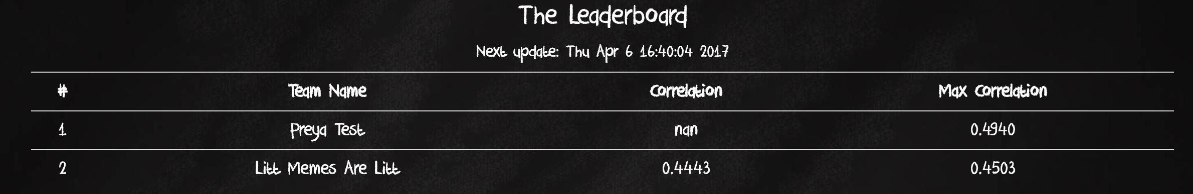
Leaderboard submission FAQs
Leaderboard will update every 6 hours (will be more frequent as we get closer to deadline
To prevent overfitting
Anybody on your team can submit (website will prompt you for your email address - make sure you use same email as your team registration email
If you (or your teammate) submit multiple times within one update period, only the last submission in that update period will get saved and evaluated
Your max correlation will also get saved

Slide 13
Deliverables: final submission
For the final submission:
We will be testing your final model on a separate validation set that you don’t have access to
Final submission will be a zip file with the make_predictions.m function (see canvas for template script), a .mat file which includes your saved model for each subject, and any auxillary files needed to run your model (e.g. libsvm library, etc).
Make_predictions.m will load the .mat containing your model(s) for each subject, run it on the validation set, and return the predictions.
TAs will run this script offline and compare your predictions to the actual values in the validation set, these correlations will be your final results

Slide 14
Deliverables: Final Project Writeup
1 report per team, due on the day of the final class meeting (4/28)
3-5 pages, 1.5 spaced (or similar) and should describe your final algorithm in detail.
See competition pdf for details (coming soon)

Slide 15
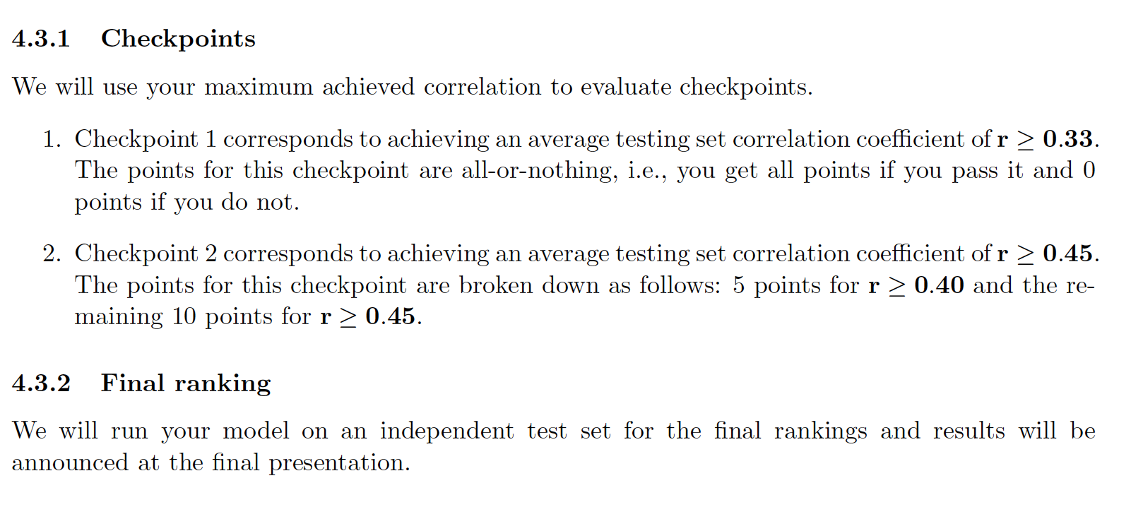
Evalulation

Slide 16
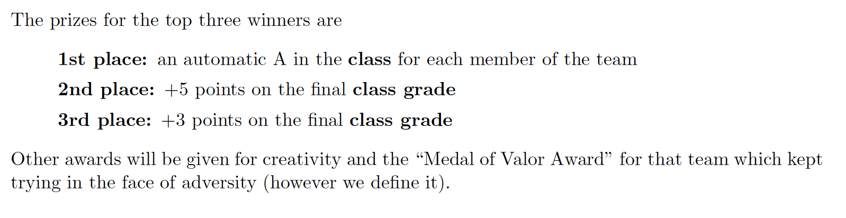
Prizes
Also: eternal fame and glory

Slide 17
Hints/tips
Start EARLY!
It will take time to read the paper, understand the assignment and the data structure, and structure your code for your first submission
Things probably will go awry - need time to debug/troubleshoot
Be a good teammate - everybody should be contributing and working hard together
Consider using git or a similar version-control mechanism to keep track of changes and make sure you don’t overwrite your teammates’ code
Be organized - can be easy to forget what models you tried and what you have yet to try, what worked and what didn’t work
Leaderboard only saves the correlations for your last submission and your best submission, you are responsible for keeping track of any other information/data

Slide 18
More hints/tips
Write good code:
Can use functions to carry out each sub-task, one main script which calls these functions
save values in variables rather than hard-coding them
Comment well, have sensible variable names
Can save and later reload results of intermediate steps to speed things up
Get familiar with using the make_predictions.m file early on, so that you’re not scrambling during your final submission
Don’t overfit to the leaderboard - use cross-validation as a mechanism to prevent that
Look at your raw data (both the ecog and the glove)
This will help you figure out what type of features might be important, whether to use a classification vs regression model, what type of pre-processing and post-processing might be helpful

Slide 19
More hints/tips
Check out the pdf for more hints/tips!!
These are key!!

